Slide 1


SAP CLOUD APPLICATION PROGRAMMING AND XSA TRAINING IN BPT
Anubhav Oberoy
Day – 7

Slide 2

Agenda – Day 7
Modeling in SAP HANA Cloud
Legacy v/s new approach of modeling
Types of calculation views in HANA
Creating Dimension Model
Creating CUBE Model
Create CUBE with Star Schema
Expose views using CAP Approach as a service

Slide 3
Modeling in SAP HANA Cloud
With SAP HANA Cloud, the main type of modeling object is called a calculation view. A calculation view can combine data from multiple tables or other views, apply filters, calculate new data and aggregate the data to produce summarizations at any level. The calculation views are developed in SAP HANA Cloud using easy-to-use graphical modeling tools, and are stored in SAP HANA Cloud database. A calculation view, when generated into a run-time object, creates a column view that can be processed by SQL.
So, instead of the application including complex code to process the data, the application now calls the required calculation views and the processing is pushed down to SAP HANA Cloud database. This is efficient in the following ways:
The application code is simplified, as it does not have to deal with many data processing tasks. These tasks are pushed down to SAP HANA Cloud database where in-memory processing takes place.
The processing on the data is carried out where the data resides, so we do not have to move raw data from the database to the application. We only move the results of the data processing to the application.
The calculation views can be reused in multiple applications so we avoid redundancy.
Calculation View
(Design-time Object)
HANA Column View
(Runtime-object)

Slide 4
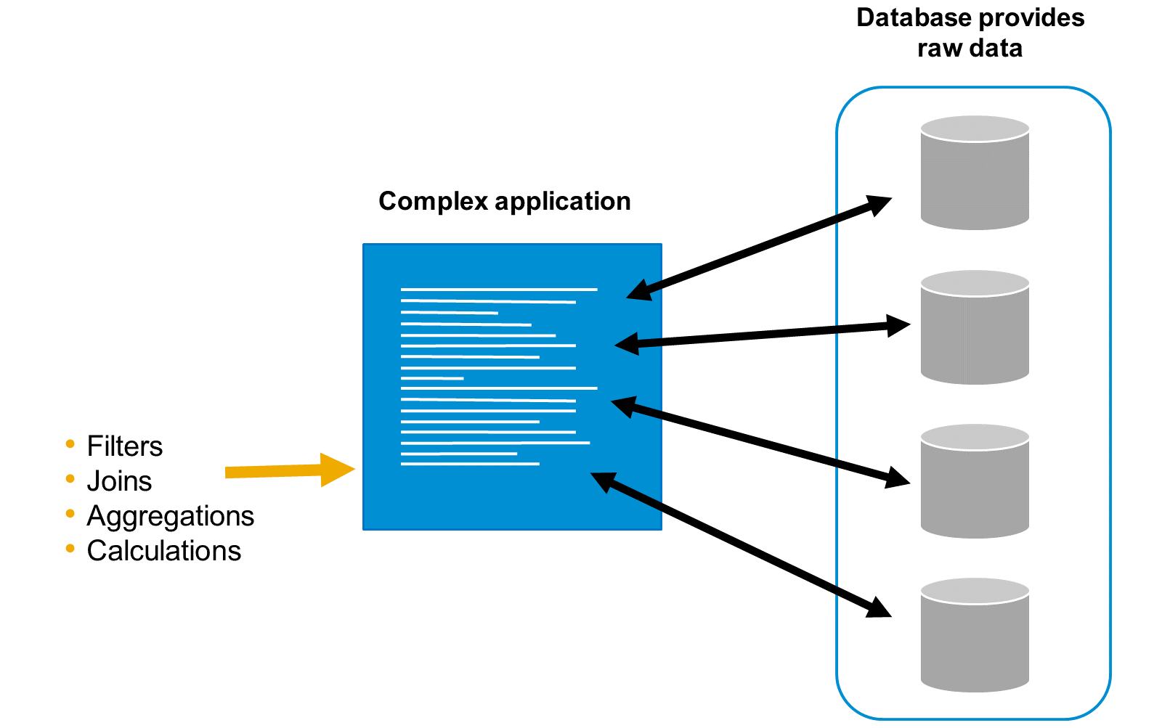
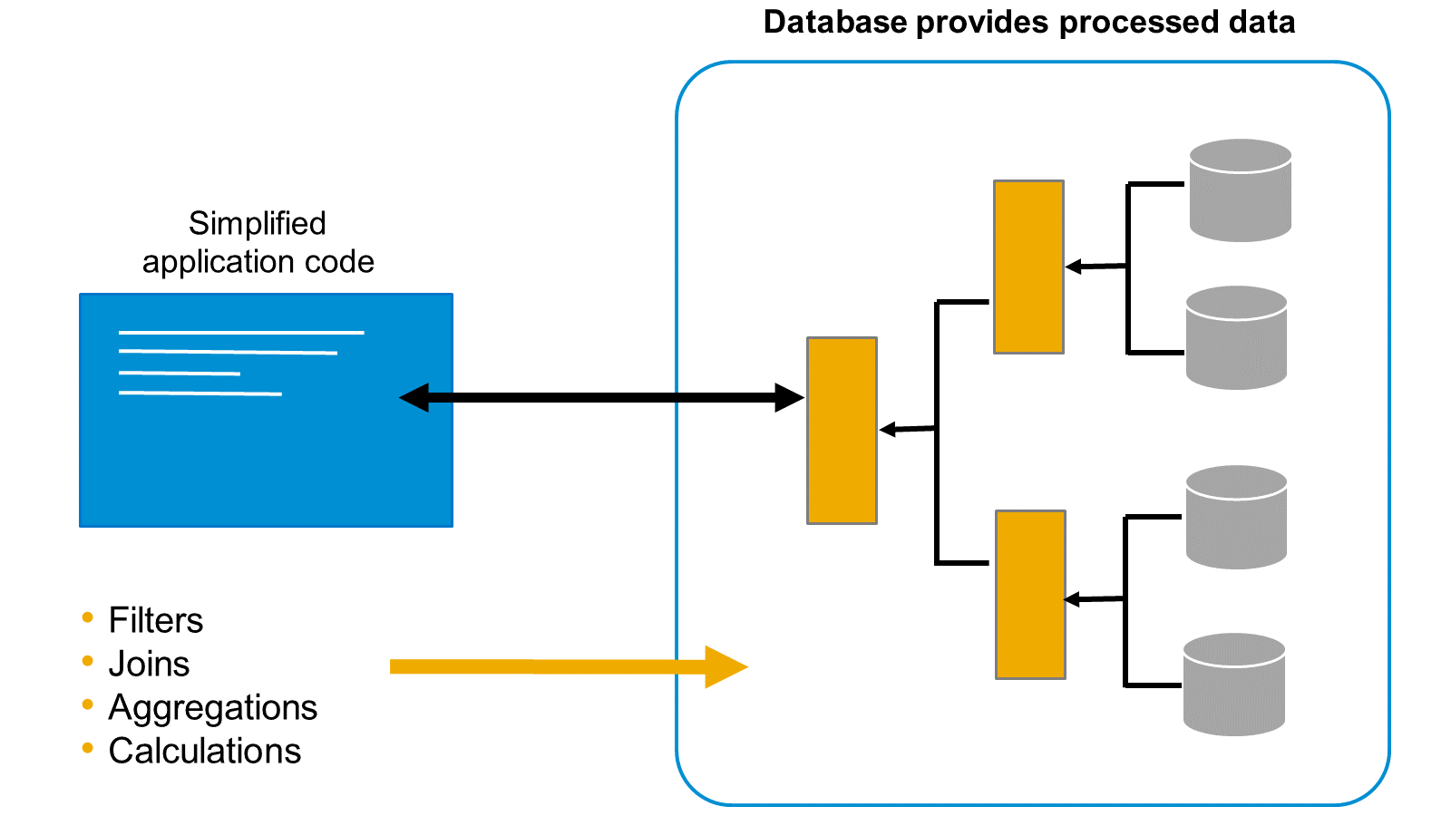
Legacy v/s New Approach of Modeling
Classical Approach
New Approach
The raw data is sent from the database directly to the application. The application then begins to process the data by combining it, aggregating it, and performing calculations in order to generate something meaningful. When we move raw data to the application layer, we make the application code very complex
With SAP HANA Cloud, we can build a sophisticated modeling layer on top of the database tables, right inside the database. This means we can first process the raw data and turn it into something meaningful in the database before passing it to the application for consumption.

Slide 5
Types of Calculation Views in HANA
The calculation view is the main modeling object in SAP HANA Cloud.
There are three types of calculation view:
Dimension - The purpose of a dimension type of calculation view is to define a group of related attributes. For example, a material dimension might include attributes such as material description, material color, material weight, and material price. It might be helpful to think of calculation views of type dimension as central master data views. You define them once and reuse them many times.
Cube without star schema-This type of calculation view is used to define a data set comprised of attributes and measures. This means they are ideal for transactional data modeling. A Cube calculation view can consume other Cube calculation views or dimension calculation views. A cube calculation view is a relational model not a dimensional model.
Cube with star schema-This model is based on the cube type of calculation view, but with one or more dimension calculation views joined to the cube. This provides a very powerful and flexible dimensional data model that enables drill-down, slice and dice analysis over any combination of attributes and measures.
Calculation views are created using a graphical editor with the tool Business Application Studio. To develop a calculation view you should be familiar with basic data modeling concepts.

Slide 6
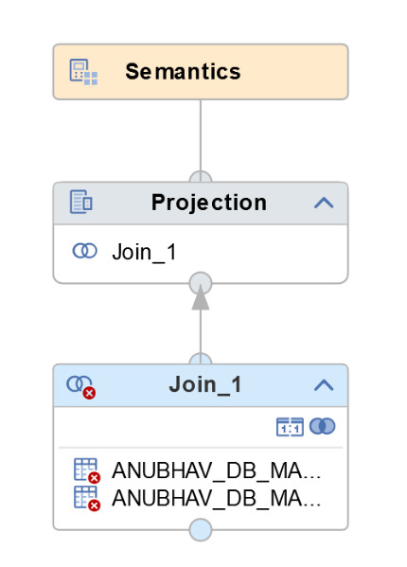
Hands-on - Creating Dimension Model
Create a new DIMENSION model to prepare master data for Business Partners and Business Partners Address.
Solution Source Code : CV_BP.hdbcalculationview

Slide 7
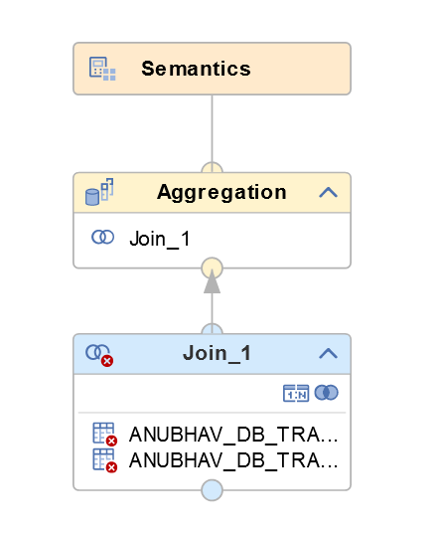
Hands-on - Creating CUBE Model
Create a new CUBE model to prepare transaction data for Purchase order header and Purchase Order Items
Solution Source Code : CV_PURC.hdbcalculationview

Slide 8
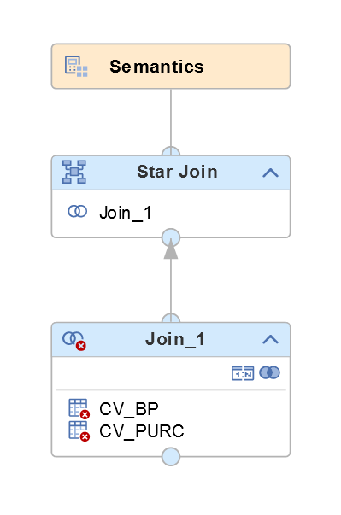
Hands-on - Creating CUBE Model (Star-join)
Create a new CUBE model to prepare data for analytics by combining master and transaction data using star join.
Solution Source Code: CV_PURCHASE.hdbcalculationview

Slide 9
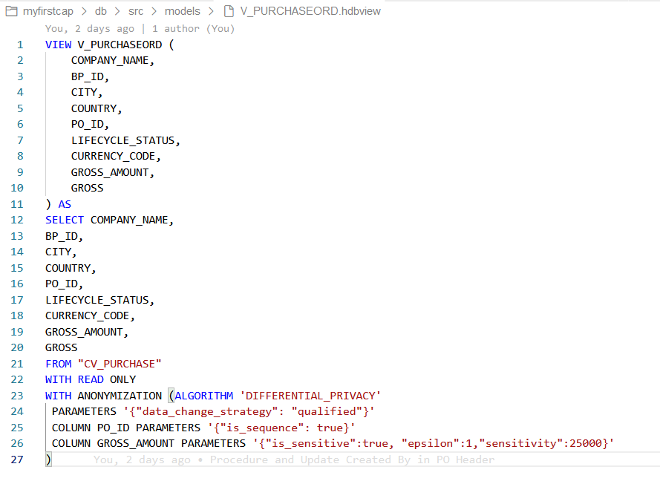
Hands-on - Creating Plain HANA View
Create a plain HANA View on top of calculation view to anonymize data.
Disclaimer: the data type is current unsupported.
Solution Source Code: V_PURCHASEORD.hdbview
REFRESH VIEW view_name ANONYMIZATION;

Slide 10
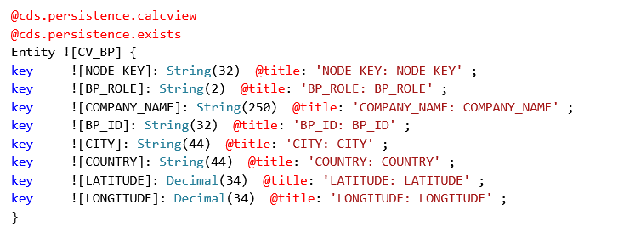
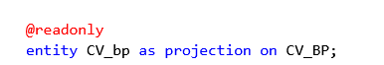
Expose View as a Service in CAP
Following are the steps to expose a view as a CAP Service in BTP
Go to the db folder inside the CAP project – cd db
Compile the View code to CDS code – hana-cli inspectView –v VIEW_NAME -o cds
Copy the generated code to the datamodel.cds file with below annotations
@cds.persistence.calcview
@cds.persistence.exists
Expose the service in CatalogService.cds file as a @readonly Entity
Test the OData Service

Slide 11
Title
Content

Slide 12

End of Day 7

Slide 13

Questions

Slide 14

Anubhav Oberoy

Slide 15


We’re committed to empower you to be
Most Desirable Resource
through powerful training solutions.
We build the workforce of the future.
750+
Corporate Clients
30,000+
Learners Trained
75000+
Learners Placed
FREE WEBINARS
Sign up for free webinars with industry experts every fortnight!
Enroll Now!
Contact us today!
https://anubhavtrainings.com/

Slide 16




More from AnubhavTrainings.com

Slide 17
Title
Content

